Slide 1

AWS - Final Project

Slide 2
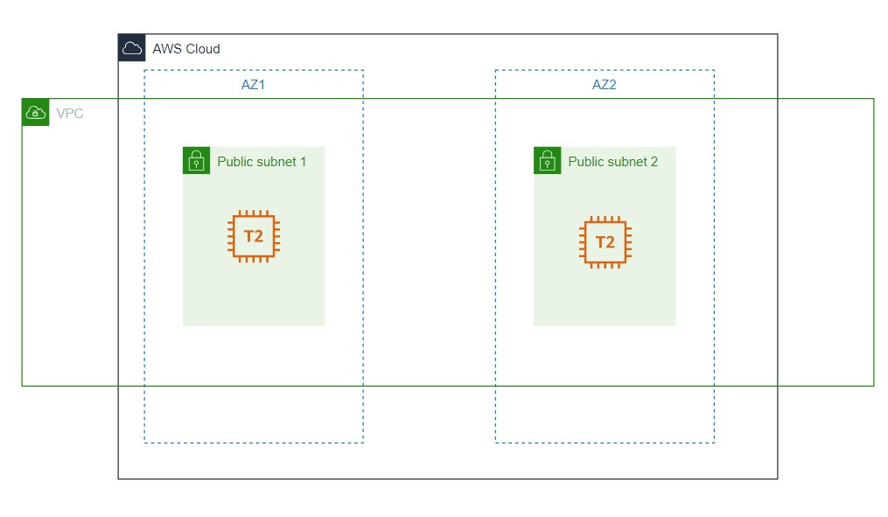
Polybot activation using AWS

Slide 3
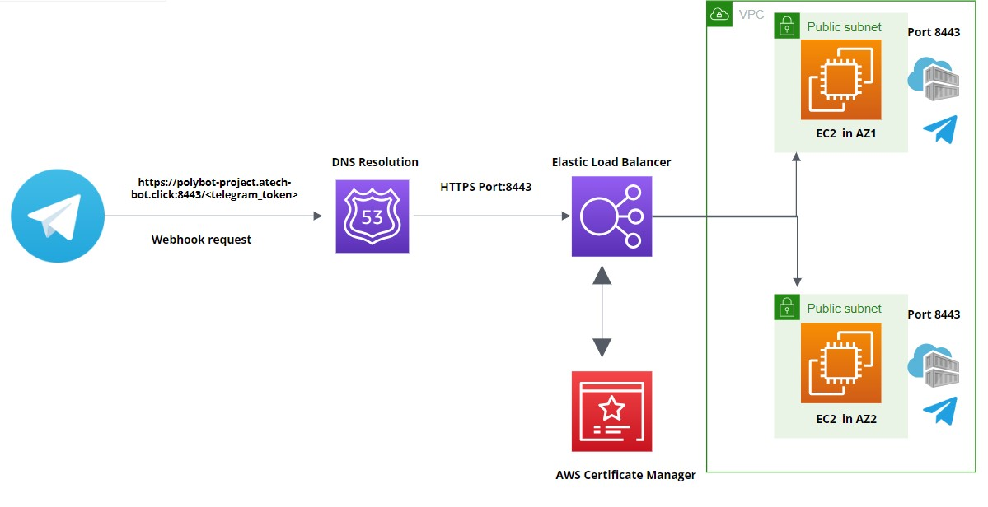
Polybot activation Flow

Slide 4
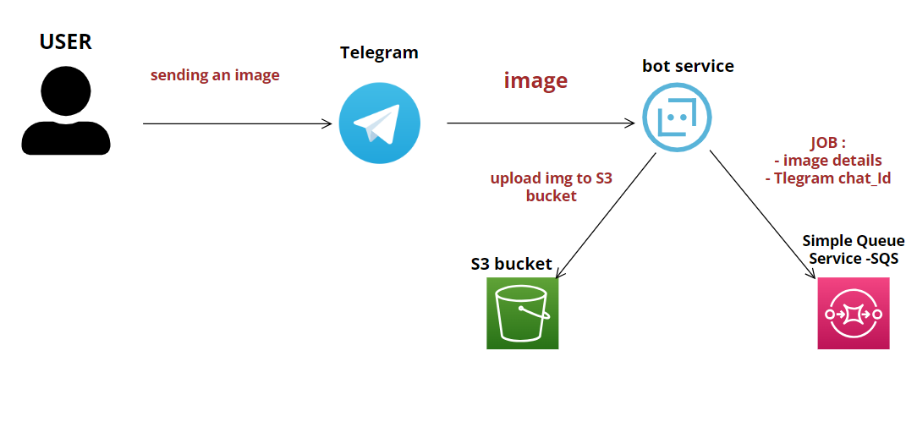
Image Processing Workflow: User to Yolo5 Service Integration

Slide 5
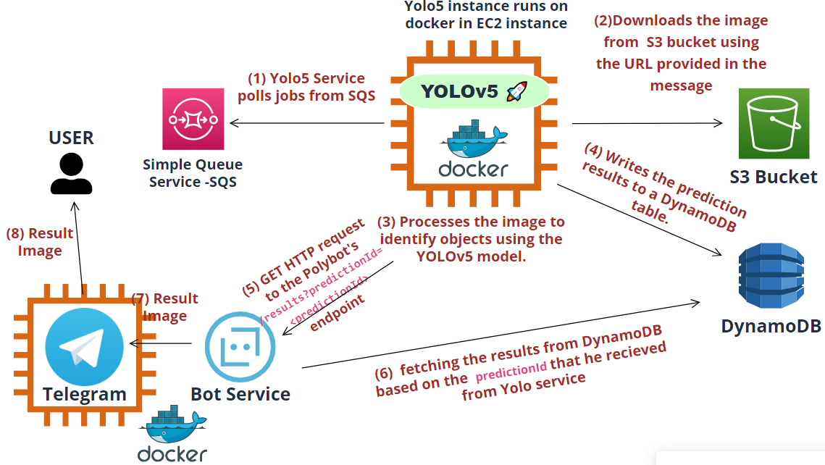
YOLO5 → PolyBot Communication

Slide 6
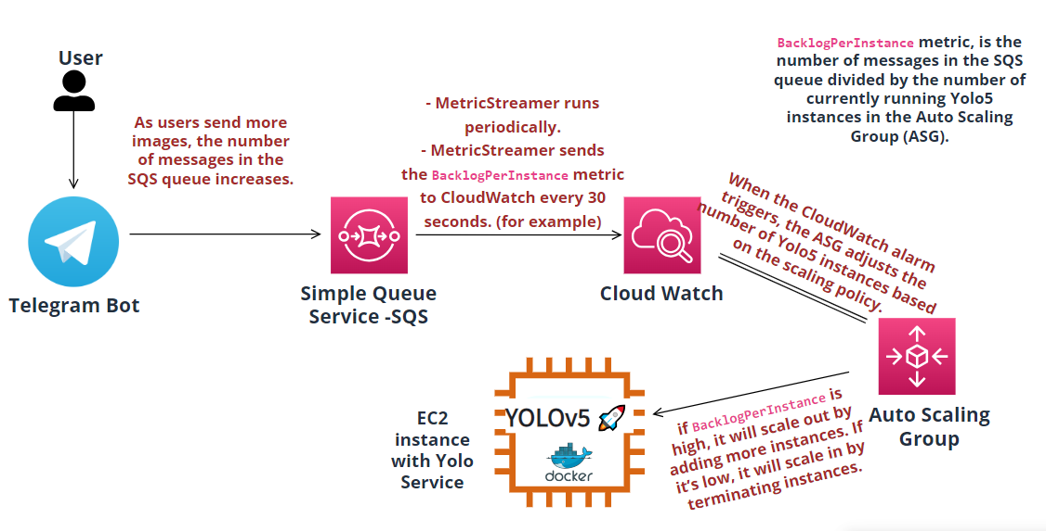
Dynamic Autoscaling of Yolo5 Service Based on SQS Queue Metrics

